Slide 1


Improve retention rate based on users’ behavior analysis
Shenghua Du

Slide 2
Improve retention ratio based on users’ behavior analysis
If we can find users have done some behavior
which makes their retention rate is higher
Then we can do some operation campaign to
help them do this behavior more actively.
For example if we find users who had given a gift
has a higher retention rate than those who had not
Then maybe we can try to give a discount to the first
gift to improve the retention rate.
Red : click“like”more than three
Blue : click “like” less than three
Reference :Music app

Slide 3
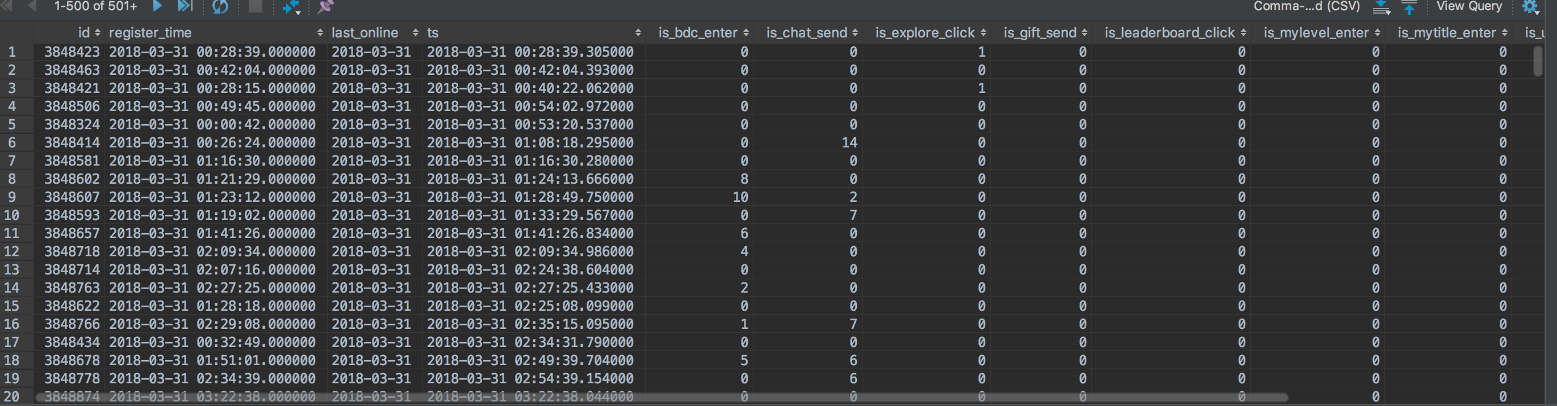
Data source and structure
bdl.loops_user_behavior
3000w data from 2018/1/1-2018/4/29
70w new user
9 user’s behaviors

Slide 4
Nine users’ behavior
is_gift_send
is_bdc_enter
is_chat_send
is_upcomming_click
is_upcomming_register
is_explore_click
is_leaderboard_click
Had been cancelled in latest version
is_my_level_enter
is_my_title_enter
Definition: The users need to do the behavior in his first online time

Slide 5
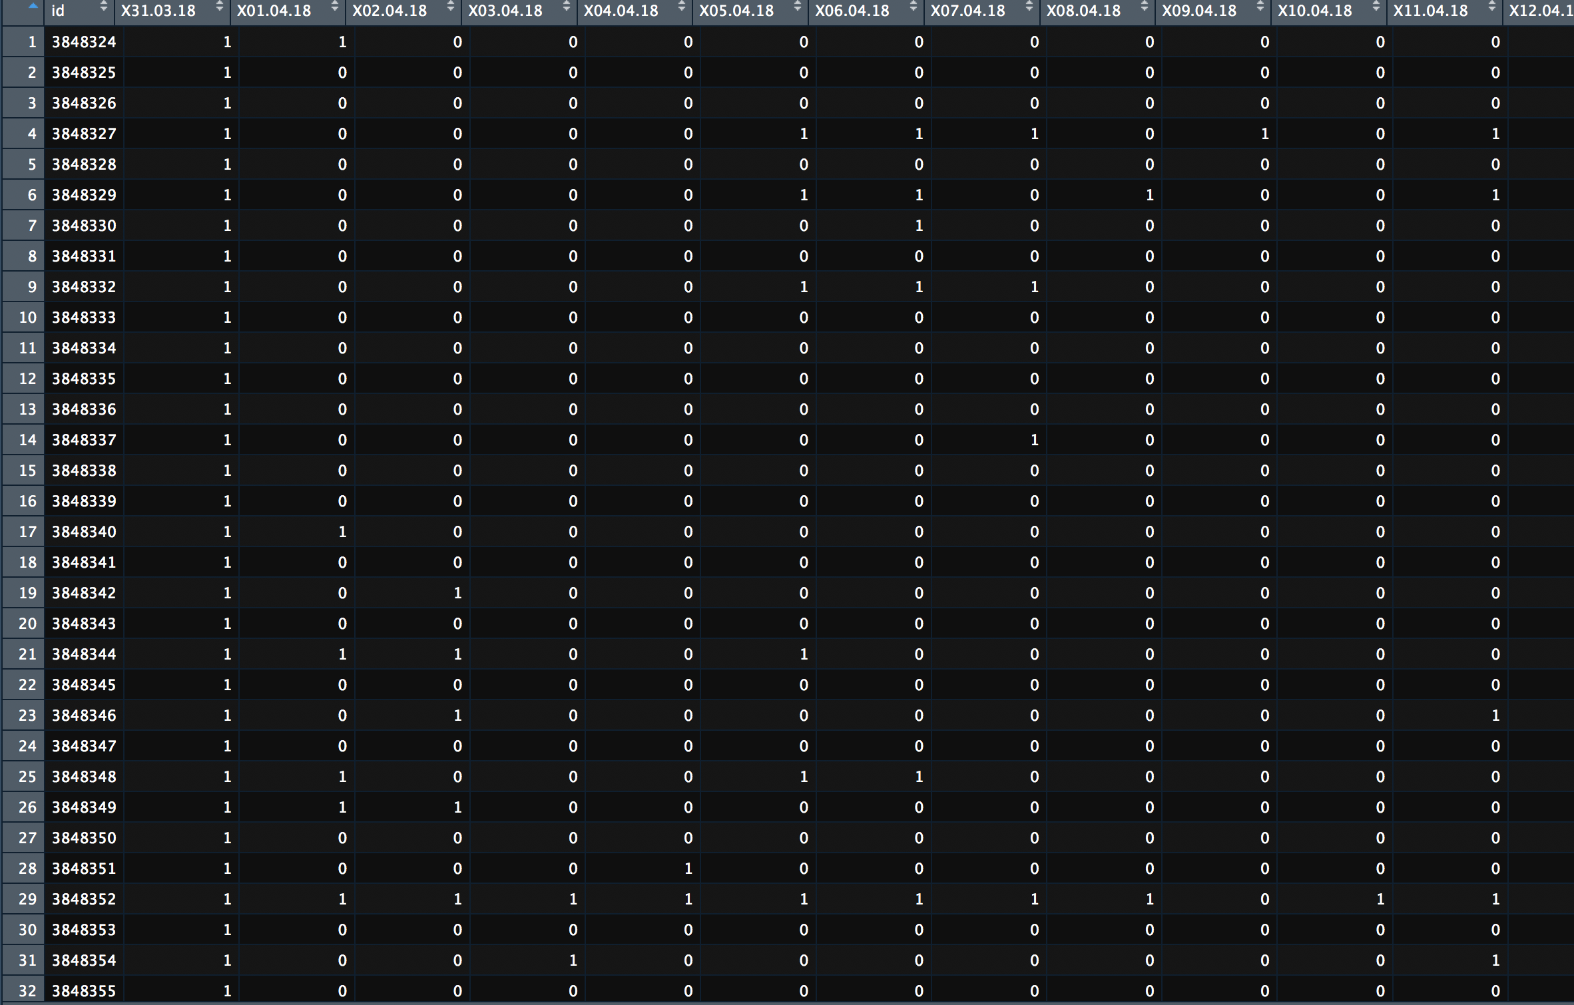
Measure and benchmark
We need to account all new users’
retention ratio and users’ who had
done the behavior active ratio in
one month separately.
If a user is online one day we
account 1 active point in one day
Then we use the accumulated point
divided by the number of users
We can get the ratio

Slide 6
Another Problem ?
How to divide people who originally have high retention rate and who are motivated by the behavior?
Who had given gift in one month
(Without training dataset)
These are what we care

Slide 7
Results

Slide 8
Results
Pay attention to the is_bdc_center and is_chat_send

Slide 9
Results
The retention ratio of users
who had been to broadcasters
is 4% higher than overall
The retention ratio of
users who had sent chat
is 20% higher than overall

Slide 10
Analysis and Conclusion
Sending chat can make user feel more interactive
When a new user enters a live room(especially broadcaster of few fans)
If he sends a chat，he will be more likely to be noticed and welcomed
by a broadcaster （especially broadcaster with few fans）
If we can make new users send chat or enter the live room
in his first online time then we can improve these new users
retention ratio and then improve the DAU

Slide 11
Strategy
1. Encourage broadcasters to welcome the new users in policy.
Then watcher is more likely to interactive with broadcasters like send chat.
(broadcaster guide)
2. First ten message rewards like experience to help user achieve level 2 more quickly ?
3. New user guide

Slide 12
Thank you

